Slide 1

CHAPTER-SEVEN
Python SQL Database Access
By: Mikiale T.

Slide 2
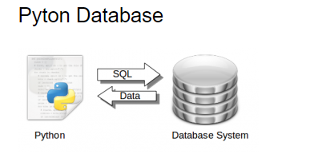
INTRODUCTION
Data is retrieved from a database system using the SQL language. Data is everywhere and software applications use that. Data is either in memory, files or databases.
Python has bindings for many database systems including MySQL, Postregsql, Oracle, Microsoft SQL Server and Maria DB.
In this chapter you will learn how to use the SQLite database management system with Python.
You will learn how to use SQLite, SQL queries, RDBMS

Slide 3
INTRODUCTION - - -
SQLite in general is a server-less database that you can use within almost all programming languages including Python.
Server-less means there is no need to install a separate server to work with SQLite so you can connect directly with the database.
SQLite is a lightweight database that can provide a relational database management system with zero-configuration because there is no need to configure or set up anything to use it.

Slide 4
SQLite Basics
There are four basic steps to working with SQLite:
Import the sqlite3 package
Connect to an existing database, or create a new database
Execute SQL statements on the database
Close the database connection

Slide 5
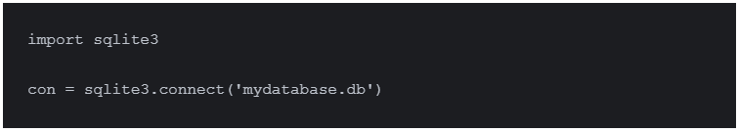
Creating Database Connection
To use SQLite3 in Python, first of all, you will have to import the sqlite3 module and then create a connection object which will connect us to the database and will let us execute the SQL statements.
You can create a connection object using the connect() function:
When you create a connection with SQLite, that will create a database file automatically if it doesn’t already exist. That will create a new file with the name ‘mydatabase.db’.
This database file is created on disk; we can also create a database in RAM by using :memory: with the connect function. This database is called in-memory database

Slide 6
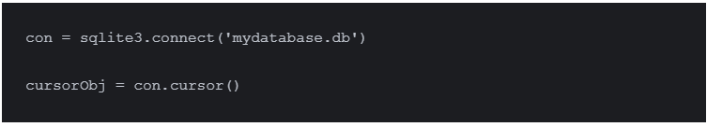
SQLite3 Cursor
To execute SQLite statements in Python, you need a cursor object. You can create it using the cursor() method. The SQLite3 cursor is a method of the connection object.
To execute the SQLite3 statements, you should establish a connection at first and then create an object of the cursor using the connection object as follows:
Now we can use the cursor object to call the execute() method to execute any SQL queries.

Slide 7
Creating Table and Inserting Values
To create a table in SQLite3, you can use the Create Table query in the execute() method. Consider the following steps:
Create a connection object and Database.
From the connection object, create a cursor object.
Using the cursor object, call the execute method with create table query as the parameter.
Insert data into table
Display data from table

Slide 8
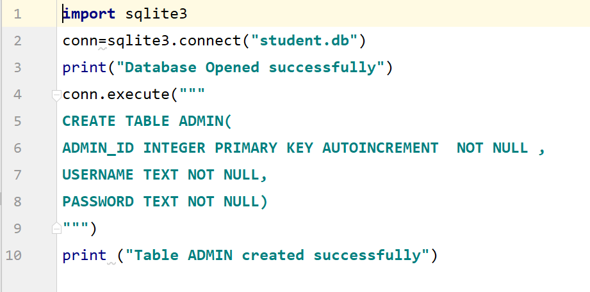
---Cont’d
To create a table, we can follow a similar pattern and write the following commands:

Slide 9
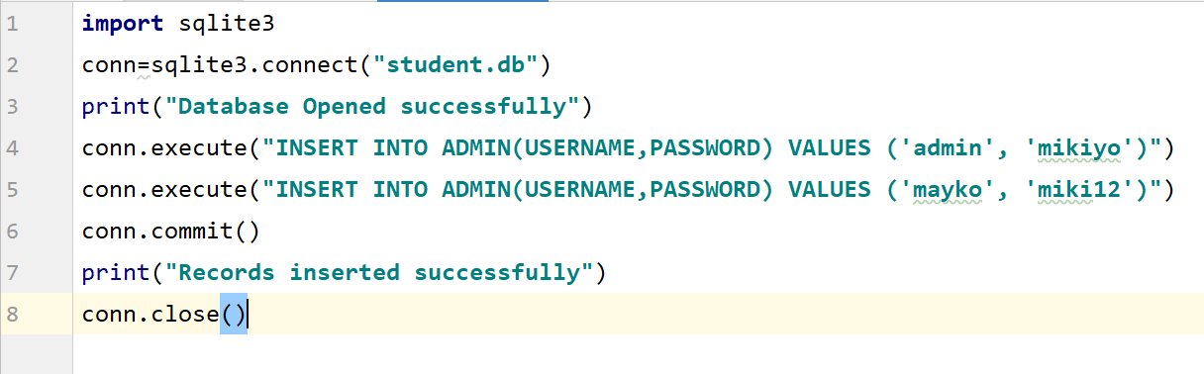
---Cont’d
Let’s take a look at how to add data with SQLite in Python to the database we just created.
To insert data in a table, we use the INSERT INTO statement. Consider the following line of code:

Slide 10
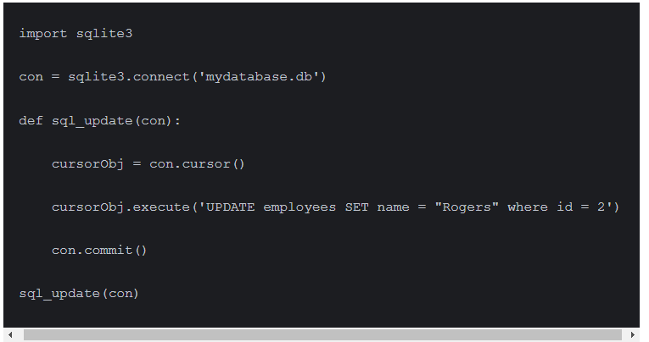
Updating Table
To update the table, simply create a connection, then create a cursor object using the connection and finally use the UPDATE statement in the execute() method.
We will use the WHERE clause as a condition to select this employee.

Slide 11
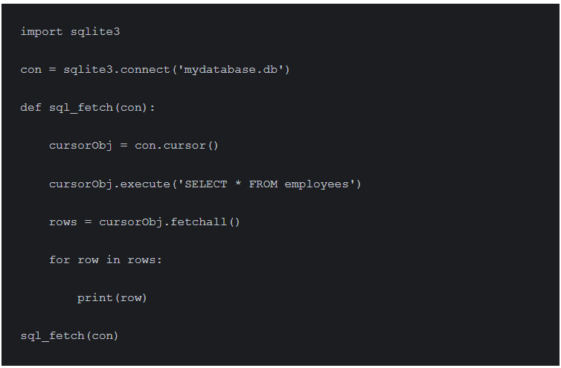
Fetch(Display) all data
To fetch the data from a database, we will execute the SELECT statement and then will use the fetchall() method of the cursor object to store the values into a variable. After that, we will loop through the variable and print all values.
The code will be like this:

Slide 12
Libraries for Working With Other SQL Databases
If you have a particular type of SQL database that you’d like to access through Python, most of the basic syntax is likely to be identical to what you just learned for SQLite.
However, you’ll need to install an additional package to interact with your database since SQLite is the only built-in option.
There are many SQL variants and corresponding Python packages available. A few of the most commonly used and reliable open-source alternatives to SQLite are:
pyodbc, which connects to ODBC (Open Database Connection) databases, such as Microsoft SQL Server
psycopg2, which connects to the PostgreSQL database
PyMySQL, which connects to MySQL databases
N.B : One difference between SQLite and other databases—besides the actual syntax of the SQL code, which changes slightly with most flavors of SQL—is that most databases require a username and password to connect.

Slide 13
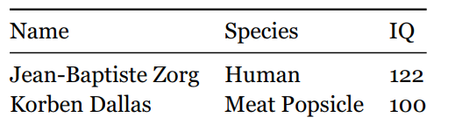

Review Exercises
Create a new database with a table named Roster that has three fields: Name, Species and IQ. The Name and Species columns should be text fields, and the IQ column should be an integer field.
Insert values to your new table with the following values:
Update the Species of Korben Dallas to be Human.
Display the names and IQs of everyone in the table classified as Human.

Slide 14


